Slide 1


Hii,
Iam Siddhika
Welcome to Power BI Series
Part -51

Slide 2



We focus only on the most used and important Dax Functions
Today Content
Meet DAX
I’m soo Excited. It’s my favourite functions.
Are you ready guys?
COMMON FUNCTION CATEGORIES
8.RELATIONSHIP FUNCTIONS
RELATED
RELATEDTABLE
RELATED VS RELATEDTABLE

Slide 3


RELATED
The RELATED function in DAX is used to retrieve values from a related table. This is particularly useful in calculated columns or measures when you want to bring in a value from another table that is related through a relationship in your data model.
Check this
Syntax
RELATED(<column>)
column: The column from the related table that you want to retrieve.
Requirements for RELATED:
There must be an existing one-to-many relationship between the two tables. The RELATED function works from the many-side of a relationship to the one-side of the relationship. This means you use RELATED in a table that has multiple rows (many-side) linked to a single row in another table (one-side).
The function requires a row context, meaning it works within each row of the many-side table to fetch corresponding data from the one-side table.
RELATED fetches data without regard to filters. This means if you have any filters applied to the data model, RELATED will still look through the entire table for the value.

Slide 4
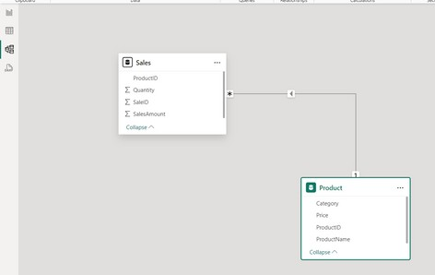

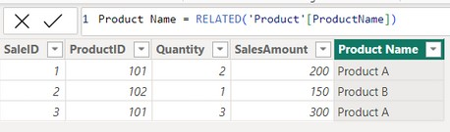
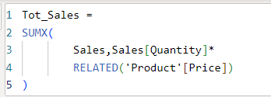

VISUAL EXAMPLE FOR BETTER UNDERSTANDING
Here just i’m taking for example to understand.
Let's consider an example where you have two tables:
Sales Table: Contains sales data.
Product Table: Contains product information.
Easy?
Using RELATED in a Calculated Column
Let's say you want to add a new column to the Sales table to show the product name from the Product table. You can use the RELATED function to achieve this.
RELATED(Product[ProductName]): This part of the formula tells DAX to look up the ProductName from the Product table for the corresponding ProductID in the current row of the Sales table.
Using RELATED in a Measure
We will create a measure to calculate the total sales value by multiplying the quantity sold by the unit price for each product.
SUMX: This function iterates over each row in the Sales table, evaluates the expression Sales[Quantity] * RELATED(Product[Price]), and returns the sum of those values.
Sales[Quantity] * RELATED(Product[Price]): For each row in the Sales table, we multiply the quantity sold by the unit price of the product. The RELATED function fetches the Price from the Product table based on the relationship between ProductID in both tables.

Slide 5

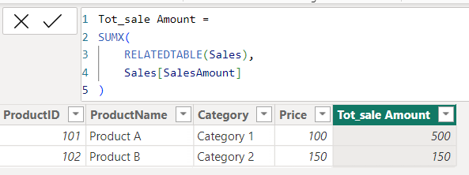
RELATEDTABLE
The RELATEDTABLE function in DAX is used to return a table that contains all the rows from a related table for the current row in the original table. This function is useful when you want to perform calculations that involve data from a related table.
It's important to have established relationships between tables for
Got it?
RELATEDTABLE to work correctly.
Used in calculated columns or measures to aggregate or perform calculations involving related data.
Syntax
RELATEDTABLE(<tableName>)
related_table: The name of the related table to retrieve.
Lets take previous tables used for RELATED function
Example
Suppose we want to calculate the total sales amount for each product. We can achieve this using the RELATEDTABLE function.
In the Product table, create a new calculated column named Total Sales Amount:
RELATEDTABLE(Sales): This returns a table containing all the rows from the Sales table that are related to the current row in the Product table based on the ProductID.
SUMX: This function iterates over each row in the related Sales table and sums the SalesAmount column.
After creating the calculated column, the Product table will look like above

Slide 6
RELATED VS RELATEDTABLE
Both the RELATED and RELATEDTABLE functions are used to access data from related tables, but they have different purposes and behaviors:
RELATED RELATEDTABLE
cleared?
The RELATED function is used to fetch a single column value from a related table.
It is commonly used in scenarios
The RELATEDTABLE function is used to fetch a table of values from a related table. This function returns a table, not a single value.
It can work with both one-to-many, many-to-many and many-to -one relationships.
where you have established one to
many relationship between tables in your data model.
You can write the related function only in many side of the table.
In summary, RELATED is for getting a specific value, and RELATEDTABLE is for getting a table of values from a related table. Both are essential in building more complex DAX expressions, especially in scenarios involving relationships between tables.

Slide 7


Thank you for joining me today to learn about Part -51 of Power BI!
Remember, Learning DAX is key to unlocking the full potential of Power BI for insightful reporting and visualization.
Stay tuned for more insights and tips on Power BI in our next Series.
Follow
Siddhika Shah

